Slide 1

A Holistic Framework for AI-Enhanced, Accessible Online Course Design
Saroj Lamichhane
Instructional Designer II, Texas A&M University-Texarkana

Slide 2
Session Learning Outcomes
Implement structured course mapping for alignment.
Integrate ADDIE and Backward Design models simultaneously.
Apply standards-based implementation for accessibility (WCAG 2.1 AA).
Integrate generative AI for content refinement and ethical student use.

Slide 3
Q1: Do you currently have a formal process/framework for AI integration in course design?
Q2: Which stage of ADDIE do you find most challenging to maintain in asynchronous environments?

Slide 4
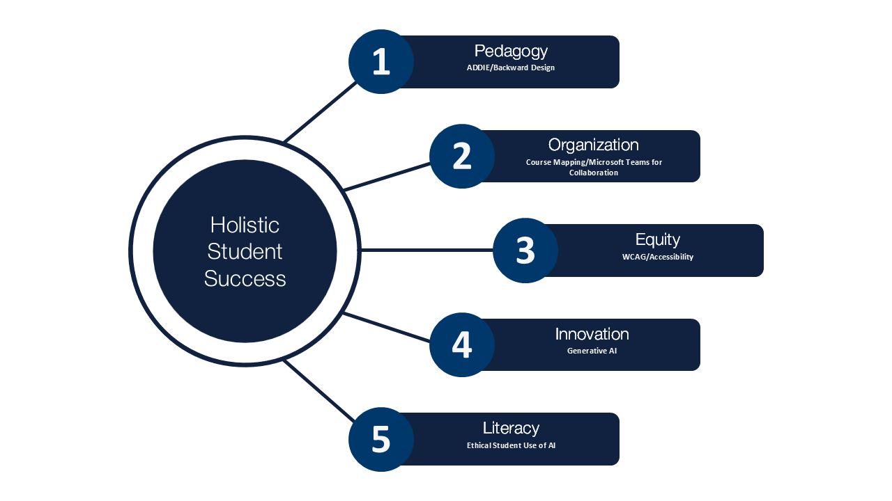
UNIV 1100 Course Design

Slide 5
The University Foundation Course Challenge
Course
1-credit freshmen required course
Shift
Moving from in-person to asynchronous online for all students
Utilizing engagement and accessibility practices to remove barriers for first-year students in an online environment.
Challenge

Slide 6
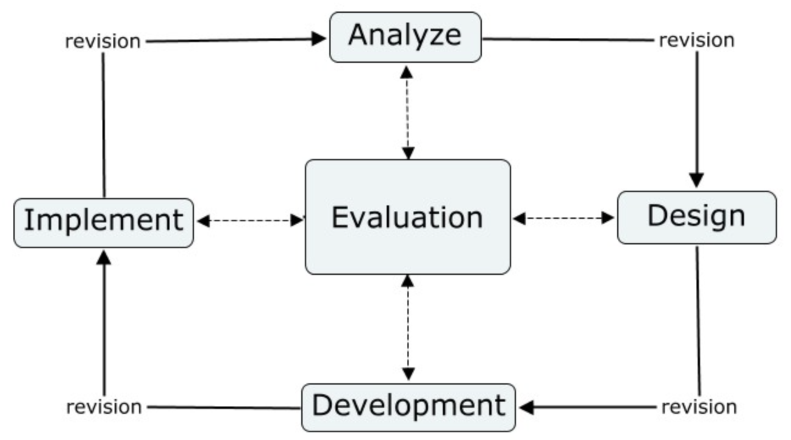
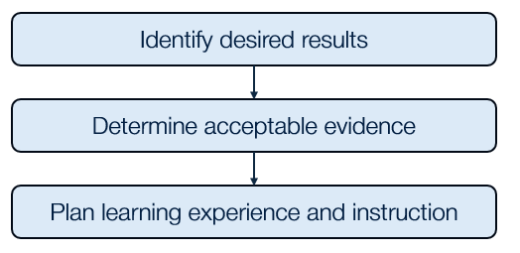
ADDIE + Backward Design Models
ADDIE: A process driven approach (Analysis, Design, Develop, Implement, and Evaluate).
Backward Design: Starting with the ‘End in Mind.'

Slide 7
Course Mapping for Alignment
The Course Map Template: Ensuring consistency across 8 modules.
Alignment Tracking: Objectives, Assessments and Learning Materials.
Learning Activities
Assessments
Learning Outcomes

Slide 8
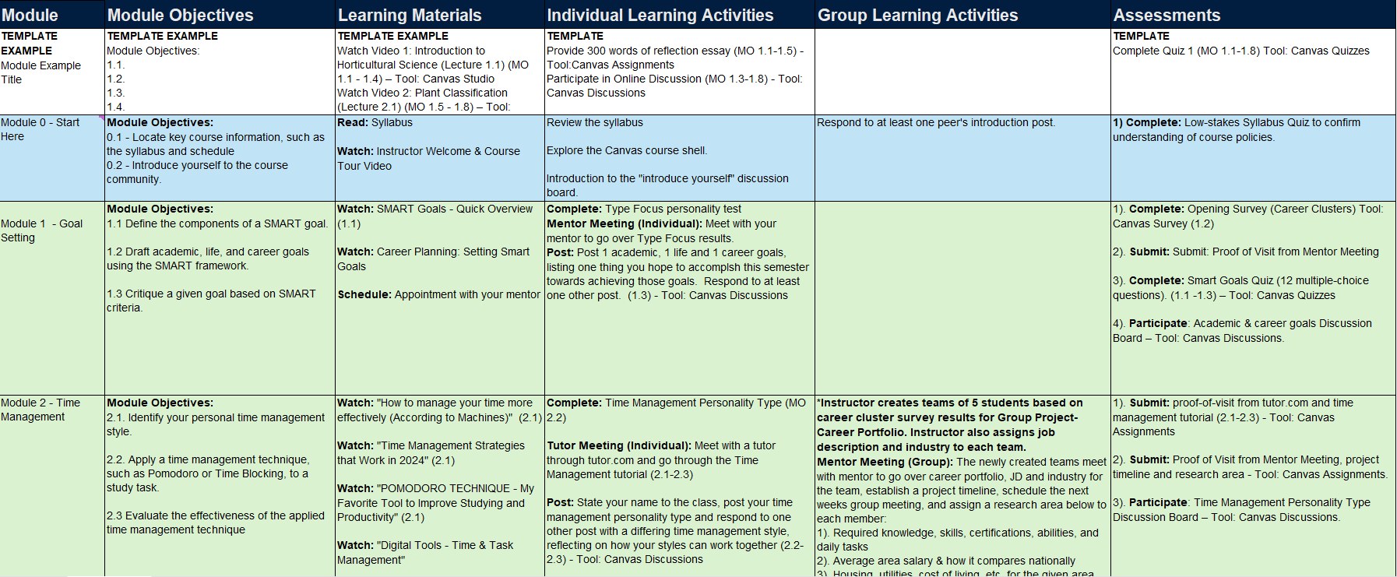
Course Mapping in Practice

Slide 9
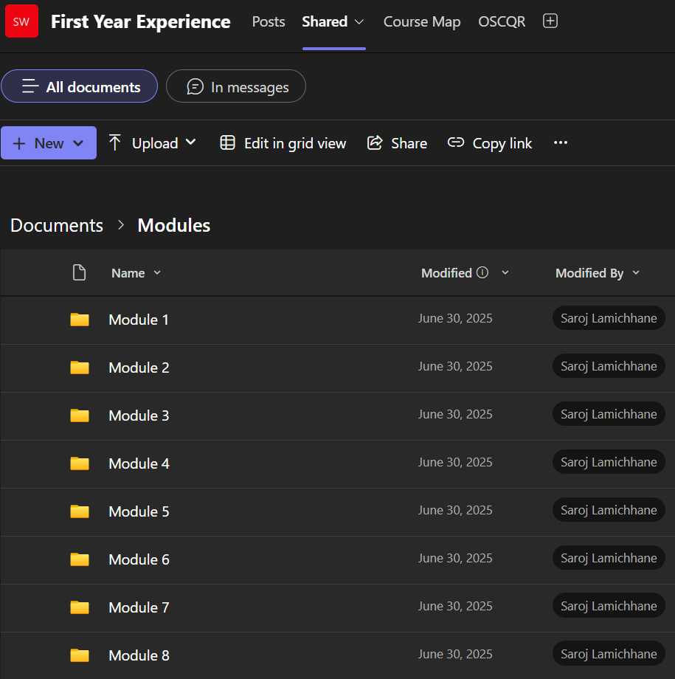
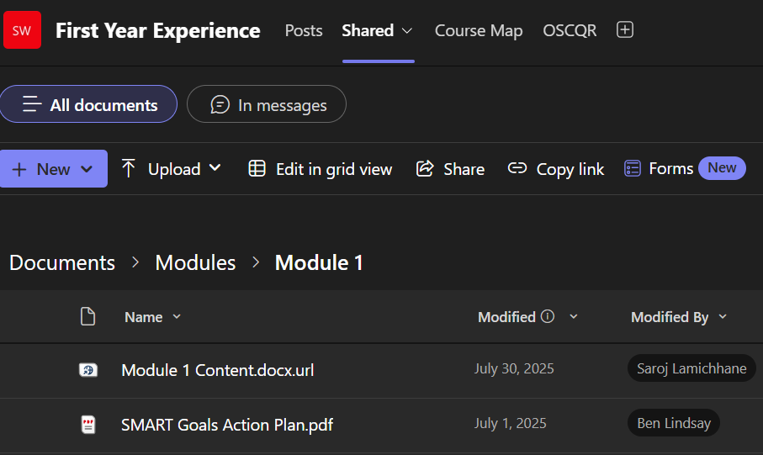
Microsoft Teams for Collaboration

Slide 10
Accessibility by Design
Proactive vs. Reactive Remediation
Following WCAG 2.1 AA standards for all Word, PPT, and PDF materials
Closed captions for are required for recorded media under WCAG (SC1.2.2).
Utilizing external links where appropriate to allow for flexibility in addressing specific accommodation requests

Slide 11
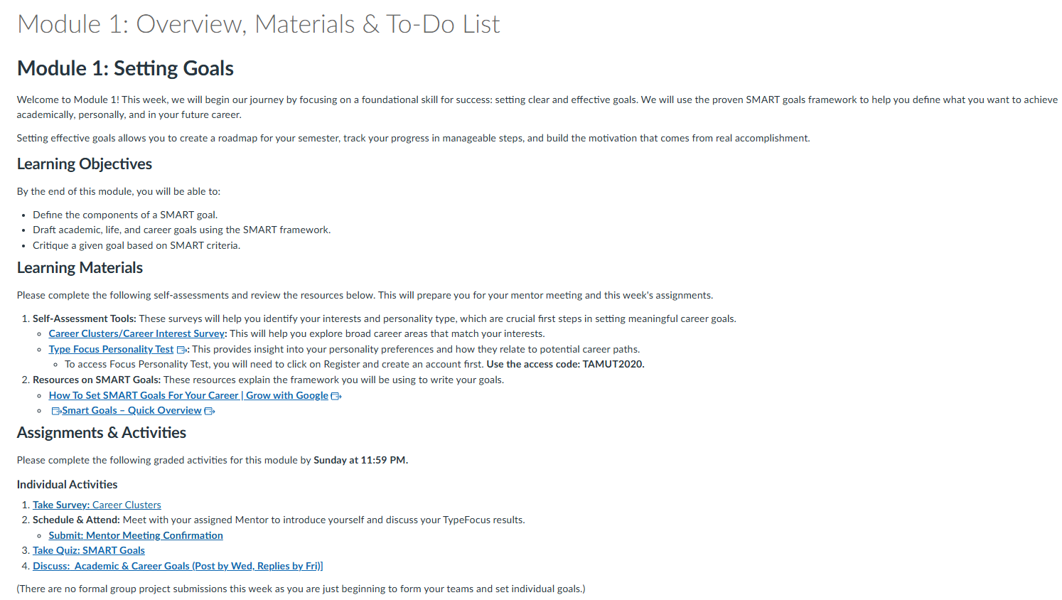
Reactive Proactive in Action
Used Canvas Pages wherever possible

Slide 12
AI as an Instructional Design Assistant
Tool: Google AI Studio for content refinement – Role-based prompting
Application: Improving clarity, conciseness, and tone for first year undergraduate students
Ensuring AI output adheres to the "Human-in-the-loop" principle
Save time or Time Consuming for accessibility

Slide 13
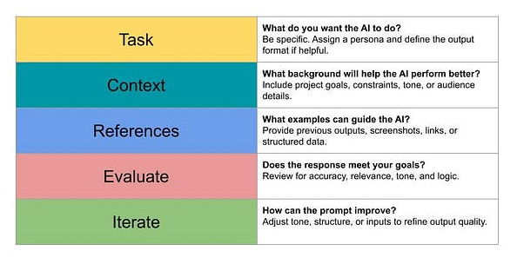
The TCREI Prompt Framework

Slide 14
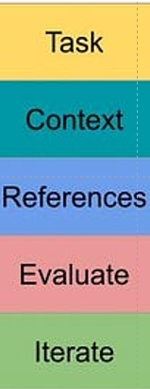
AI Prompt in Action
You are a professional instructional designer with over 40 years of experience. You are supporting the development of a course titled [Course Name] for first-year students at [University Name]. Your primary role is to assist another instructional designer by reviewing provided documents and providing recommendation on the content and layout that must meet the following requirements:
Adheres to OSCQR (Open SUNY Course Quality Review) standards
Complies with Web Content Accessibility Guidelines 2.1 AA.
You may be asked to create, suggest, or revise course materials, including module objectives, learning activities, and assessments, based on the documents provided.
⚠️ Important Instruction:
If you are asked to complete a task that is the responsibility of the course faculty—such as selecting final course grades, determining official course outcomes, choosing textbooks, or making academic decisions—do not perform that task.
Instead, respond with the following message:
""This task must be completed by faculty.""
Always maintain a clear boundary between instructional design support and faculty responsibilities

Slide 15
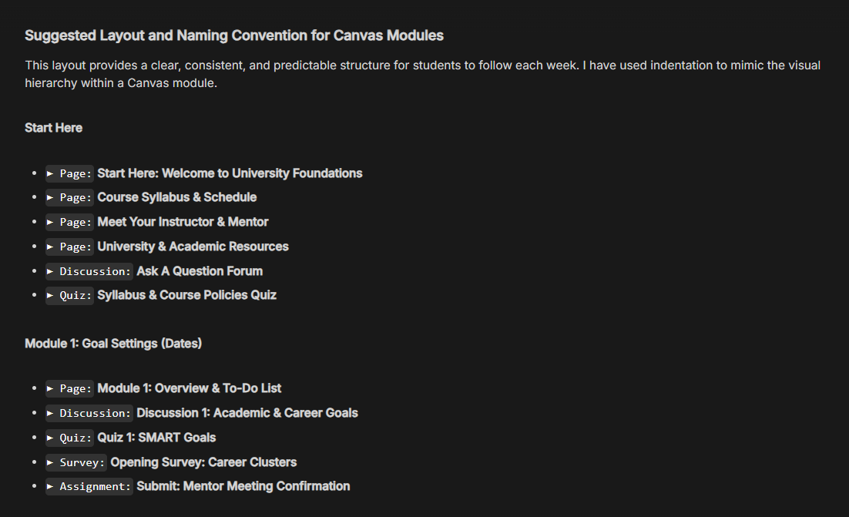
AI Output for Course Structure

Slide 16
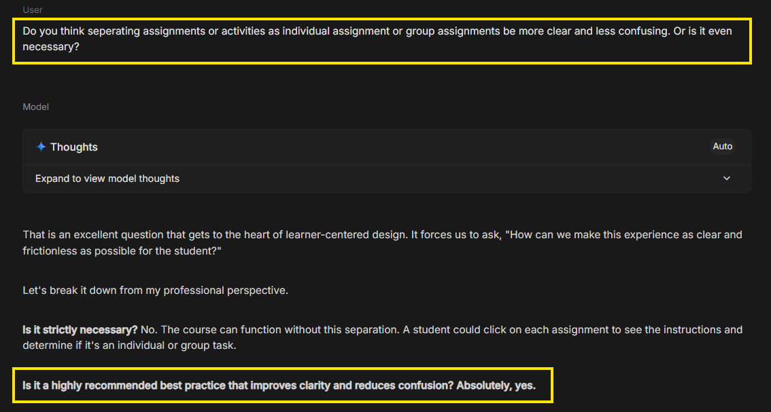
AI Prompt – Follow Up

Slide 17
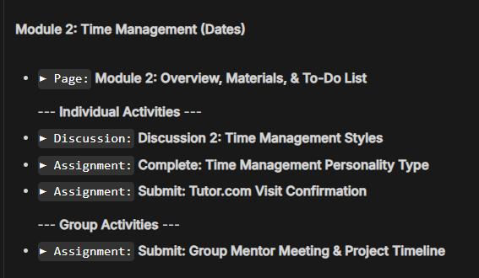
AI Revised Suggestions

Slide 18
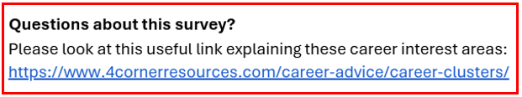
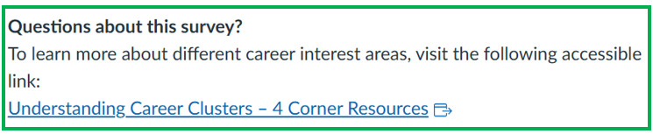
AI Output for Accessible Content Remediation
Before
After

Slide 19
Ethical AI Use for Students
Assignment: The Career Portfolio Project (Resume & Cover Letter).
Requirement: Students must ‘audit' the AI output for bias and inaccuracies.
Goal: Moving from restriction to "Responsible Application."

Slide 20
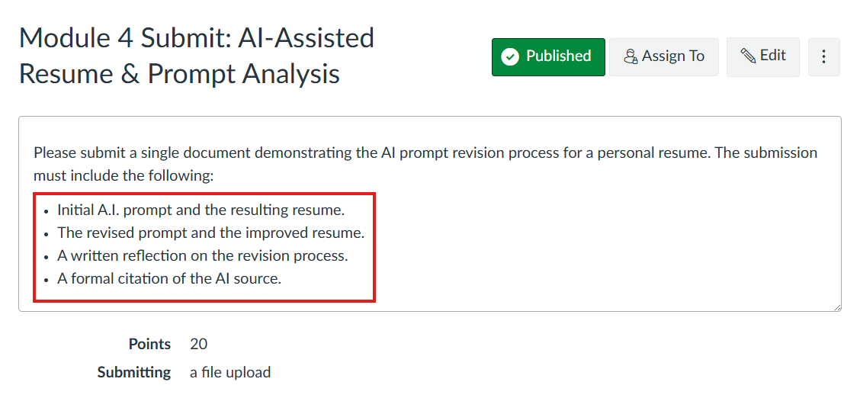
Ethical AI Use in Action

Slide 21
Activity: The 8-Week Module Makeover
Scenario: A 45-minute uncaptioned lecture video and a 20-page scanned "image-only" PDF; Assessment: a generic 500-word reflection essay.
Apply the Holistic Framework (3-5 Minutes)
  Following Backward Design, How would you "chunk" or trim this content for an 8-week, 1-credit workload?
  To meet WCAG 2.1 AA, what must be done for the video and PDF?
  How could Google AI Studio help you "translate" that 20-page reading into a concise, accessible instructional message?

Slide 22
Observations & Action Plan
Content versus semester duration
Group formation challenge
Scheduling conflicts with mentor
Learning Management System/Canvas familiarity
Instructor meaningful presence in course
Closing the Loop

Slide 23
References
https://wcet.wiche.edu/frontiers/2021/08/26/rsi-refresh-sharing-our-best-interpretation-guidance-requirements/
https://aistudio.google.com/prompts/new_chat
https://oscqr.suny.edu/
https://tll.mit.edu/teaching-resources/course-design/backward-design/
https://commons.hostos.cuny.edu/edtech/faculty/teaching-with-technology/instructional-design/addie/
Google Prompting Essentials, https://grow.google/prompting-essentials/
https://medium.com/@CobiOneCanobi/why-prompt-engineering-is-the-most-important-ai-skill-youre-not-learning-7432dc9e7aff

Slide 24
Q&A

